Slide 1

Juggling the Demands of the Standards with Your ELL Students
Richard Di Giacomo
Magnifico Publications
krinibar@aol.com

Slide 2
The English language learner students cannot be ignored
1/6 of our students in California are ELD
In many schools the proportion is substantially higher
In schools with a lower ELD population the students are not being adequately served
The needs of this student population must be met

Slide 3
The demands of the History–Social Science Content Standards for California are clear:
“Teachers should organize their instruction based upon their students’ academic literacy in the discipline, their overall English literacy, and their content understanding. More specifically, an instructional approach that includes substantive oral language interaction, appropriate pacing of concepts, strategic grammar instruction, increased feedback, and research-based literacy strategies designed specifically for learning the individual disciplines within the history–social science framework is one most likely to produce gains in both student content understanding and literacy."

Slide 4

The Challenge:
The challenge for teachers is to teach grammar, reading, and writing strategies while also meeting the content standards for their grade level.
There is definitely a wall that ELD students face when trying to learn history due to their lack of prior knowledge and English fluency.

Slide 5
While our students may be hard workers and highly motivated…
They lack much of the prior knowledge of Americana that native born students take for granted
They have not grown up interacting with the American government or democratic practices
They may have not been literate in their home country
The historiography and pedagogy in their home country may have been deficient or highly propagandistic
Our students may not have completed primary school

Slide 6
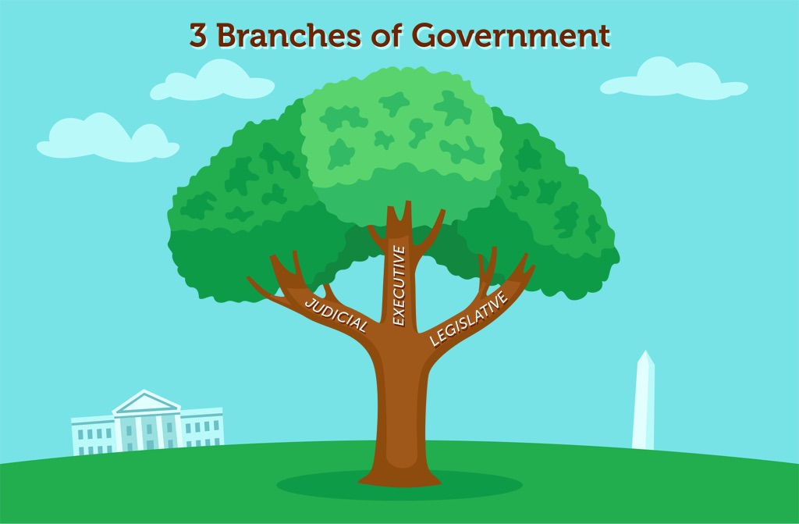
My quandary:
I had to teach Government to 12th graders who had a 6th grade reading level and no prior experience with the U.S. Constitution because they were not here in 8th grade. No one understood the 3 branches of government.
Solution: I brought in actual tree branches!

Slide 7
Frustrations for students
Many times students understand the concept, but cannot express it in English
Mixed ability levels and multiple primary languages in the same classroom
Lack of teacher aides who are fluent in the target languages
Teachers sometimes talk too fast or use too many idioms
Some teachers assume that students understand them because no one is asking questions

Slide 8



One solution
Imbed language arts components in your social studies lessons
Blend the course content in history and the grammar components that are necessary both for comprehension of the subject matter and general English fluency

Slide 9
Each book contains:
Hands-on, sheltered classroom activities that take advantage of multiple learning styles and differing language acquisition levels. These are often very active and engaging.
Grammar exercises based on the vocabulary of the lesson that reinforce both grammar skills and content area goals. These exercises will help build stronger readers and writers while reinforcing the main ideas of the course content in history.

Slide 10
Written by teachers for teachers
The lessons grew out of a lack of quality materials that were available for ELD students
Many existing materials were either too childlike for middle and high school students or merely texts from earlier grades. Many lack hand-on activities.
These lessons are aligned with Common Core Standards for the Social Studies and with the National Standards for Social Studies.

Slide 11
An Example:
Polynesian Migration Simulation
Duration: 1 hour
Objectives: To learn group decision making in a historical context
To appreciate the difficulty of Polynesian voyages of discovery
Language Component: Declarative sentences
Materials: Writing materials, books and/or websites about Ancient Polynesia
A copy of the Polynesian Migration Simulation handout for each group

Slide 12
Procedure
1. Review the rules for making declarative sentences. 2. Briefly summarize a typical Polynesian voyage of discovery. 3. Divide your class in to small groups of 2–4 students of mixed ability levels. 3. Give each group a copy of the Polynesian Migration Simulation handout.
The students in each group then read the description of cargo items and personnel and debate among themselves who and what to bring. They may adjust and recalculate the totals as many times as needed, but must not exceed the total final weight of 22,000 lb. of carrying capacity for the two ships. As the students are debating, they should practice making declarative sentences such as, “We have to include a navigator,” or “We must take more water!”
Have each group summarize their choices to the whole class and justify why they chose to leave some items or people behind.
Teacher Recommendations:
This activity is best completed after you have already given students an overview of why and how Polynesian voyages of discovery were conducted.
It is a good idea to include at least one student with good math speaking and writing skills in each group. Keep students under time pressure to come to a decision on what to carry on the ships, otherwise they will deliberate indefinitely. No more than 30 minutes should be allowed. Supervise each group to make sure that everyone is participating. Make suggestions as needed.

Slide 13
Evaluation
Have students discuss and write answers to the following debriefing questions:
What kinds of things did you take with you and what did you leave behind and why?
Why did the Polynesians find it necessary to migrate over such vast distances?
Why were some of their destinations some of the last places found on earth?
Do you think they might have traveled all the way to North or South America? If so, why didn’t they settle there?
What kinds of things did they take with them that where unfamiliar to you?
What kinds of things were unknown to them that would have made their voyages easier?

Slide 14
Student handout
Directions: You are a group of 48 Polynesians who have been asked to leave your island because it is too overcrowded to support any more people. You are forming an expedition to go to find a new island to settle. Two large canoes have been built for your journey. You must decide which people to bring and what kinds of things to take with you. Each canoe holds about 11,000 lb. of carrying capacity. You must divide the available space up among the passengers and the cargo. Discuss with your group why each item should be included on your journey or left behind. If you decide an item or person is important, decide how many of the following to take with you on your voyage to set up a new colony on a faraway island. If you decide to take a person or item with you, indicate how many pounds total of them in the blank to the right of the item or person. If you decide to leave something behind, cross it out. Total up the weight carried for all of the cargo, and then all of the people. Add the total weight together. If you exceed the total amount of 11,000 lb., decide which items or people will be eliminated from the trip.
Cargo: bananas (bunches of 100 lb.), yams (baskets of 100 lb.), hooks (1/2 lb. each), spears (10 lb. each) etc.
People: Ax maker (200 lb.) Farmer (200 lb.) Fisherman (185 lb.) Priest (190 lb.) etc.
Subtotal of people's weight ________________________
Subtotal of people's weight + Subtotal of goods' weight = Combined total of weight carried on board ________________________
If you exceed the total amount of 11,000 lb., decide which items or people will be eliminated from the trip.
(5 lb. each)

Slide 15
An Example from U.S. History
GULF WAR PASSAGE
Directions: Change the verb tenses in the reading below to the proper irregular verbs. Write the correct word above the underlined words in the reading below:
The Gulf War has been knowed by many names. Some call it the Persian Gulf War, the Iraqi War, or the First Gulf War. The war arised because the United States had promised to protect the free flow of oil through the Persian Gulf. As early as when Jimmy Carter was president, the United States had flyed American flags on oil tankers from Kuwait to show that we planned to protect them if necessary. The conflict beginned in 1991 when Iraqi president Saddam Hussein taked over Kuwait because he claimed that the land had once belonged to Iraq. What really happened was that there was a large amount of oil to be getted along the border of the two countries and that Hussein wanted it all for himself. The United States gived a warning to Hussein not to invade, but his army stealed the oil when they invaded the tiny country anyway. The United States then decided to free Kuwait by taking it back from Iraq. In order to do this the United States drawed upon help from many of Iraq’s neighbors who were also afraid of being took over by Iraq. Although Hussein said the defense of Iraq would be “The mother of all battles,” the United States beated Iraq’s army easily.
President George H.W. Bush choosed not to try to capture the capital of Iraq, Baghdad. He feeled that it would be too difficult for the United States to occupy Iraq for a long period of time. He thinked that all that was necessary to win the war was to stop Hussein from invading Saudi Arabia or other neighboring countries. He sayed that as long as we freed Kuwait, that was enough. He sayed a longer war to take over all of Iraq would not be a good idea for America because it would take too long and be difficult to govern once we winned it. It would be leaved to George Bush’s son George W. Bush to overthrow Hussein and occupy all of Iraq in an attempt to build a new democratic government there.
The First Persian Gulf War Student Handout © 2016 Social Studies School Service

Slide 16
World History Activities for English Language Learners
Ancient to Medieval ISBN 9781596475281
Contents:
Plant and Animal Origins Invent Your Own Writing System Royal Nicknames Ancient Egypt
Monument to a Pharaoh Competition Mysteries of the Indus River Valley Civilization Hebrew Writings Lesser-known Ancient Cultures
Oversimplified Modifiers Ancient Persia Details and Definitions
Ancient Greece Newspaper Roman Inventions Chinese Dynasties Group Report
Myths of Ancient and Medieval Africa Identify My Mayan Drawing
Aztec Trade Simulation Incan Incompletes Comparing Major Religions of Asia
That Came From India Too? An Early Christian on Trial Fall of Rome Debate
Germanic Origins of English Barbarian Invasions from Asia Building a Feudal Pyramid
Medieval Explorers Cartoon
Polynesian Migration Simulation Samurai Social Media

Slide 17
World History Activities for English Language Learners Renaissance to the 21st Century
ISBN 9781560049630
Monarchy Report Renaissance Newspaper Patronage Proposal Form Scientific Revolution Bingo
Explorers Matching Game Explorers Grammar Exercise Comparison of Colonies Chart
Divide and Conquer Reformation Cartoons Enlightenment Letters French Revolution Vocabulary Letter from Napoleon’s Soldier Latin American Independence
Industrial Revolution Inventions: Identify My Drawing The Race for Resources Game
Explorers of Africa Simulation
Taking Colonies World War I World War II Battles Decolonization Children’s Book
Origins of the Cold War Group Interview Korean War Decisions The Vietnam War The Space Race
Mao Propaganda Posters Arab-Israeli Wars Crises of the 1970s: “Time to Lay It on the Line!”
Iranian Hostage Crisis Tiananmen Square Fishbowl Activity The First Persian Gulf War
The End of the Cold War:
How We Came to the United States George W. Bush and the
War on Terror Graphic Organizer Technological Revolution

Slide 18
US History Activities for English Language Learners
Age of Exploration—21st Century ISBN 9781560049487
Locate the Tribe Age of Exploration Explorers Grammar Comparison of American Colonies
“Dear King George . . .” American Revolution Language Lesson War of 1812 Game Manifest Destiny Word List Imaginary 49er Letter
Antebellum Newspaper Civil War Quotations Reconstruction The Indian Wars The Industrial Revolution
The Progressive Era American Imperialism Homonym Activity Taking Colonies: A US History World War I
The Great Depression Cartoons World War II Battles Origins of the Cold War Korean War Decisions Civil Rights Opinions
The Space Race News Report The Vietnam War 1960s Social Movements Hippie Day
Nixon’s Watergate Speech Mind Mapping the Reagan Era Gulf War Passage The End of the Cold War: How We Came to the United States
War on Terror Graphic Organizer Twentieth Century Slang

Slide 19
Sharing Time
Any questions on how to implement this teaching strategy?
Could you develop lessons like this own your own?
What are some of your strategies that work?

Slide 20
Book Signing
I will be doing a Book Signing at the Social Studies School Service booth 500-501 at 2 p.m. today.
My contact information is
Richard Di Giacomo krinibar@aol.com
www.socialstudies.com
www.magnificopublications
(408) 286-5179

